Slide 1
Rockbuster Movie Rental Analysis

Slide 2
Why did an analysis need to be taken?
Streaming services such as Netlfix are stiff competition to the company, we plan to launch our own streaming service
In order to learn new insights into launching our own streaming service, we need to load the data into RDBMS in order to analyze the data
This will allow us to answer questions that each department may have

Slide 3
Our Findings
Descriptive analysis (statistical analysis) of various films and customers
Countries with the top customers
Cities with the most customers
Amount paid by the top 5 customers
Notes:
If this was a presentation, I would describe some of the statistics we found, such as the average, min and max. Then I would explain to the managers how the top 10 countries will be able to help them launch their streaming service.

Slide 4
Descriptive Analysis
Name | Maximum | Minimum | Average
Rental Duration | 7 days | 3 days | 5 days
Rental Rate | $0.99 | $4.99 | $2.98
Replacement Cost | $9.99 | $29.99 | $19.98
Notes:
So here I decided to only show the relevant tables that the stakeholders would want to see. I do not think they would be interested in which rating most customers are interested in because in the project brief they were only interested in the average rental duration. I also decided to not make a visualization in Tableau because I could easily make a table within my presentation within my PowerPoint.

Slide 5
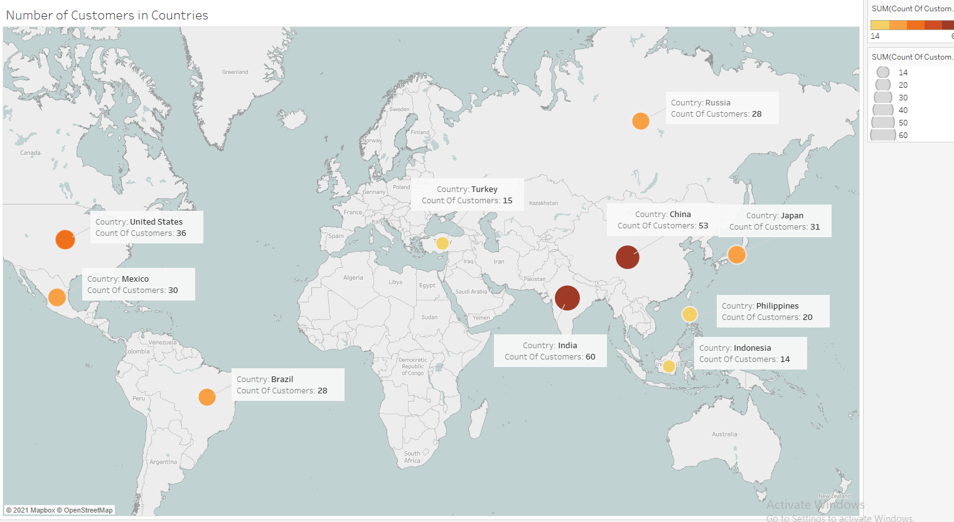
Notes:
“As you can see, a majority of customers can be found within Asia and the Americas. With India, China and the US holding the top number of customers. This can help us to see where we should launch our streaming service first”

Slide 6
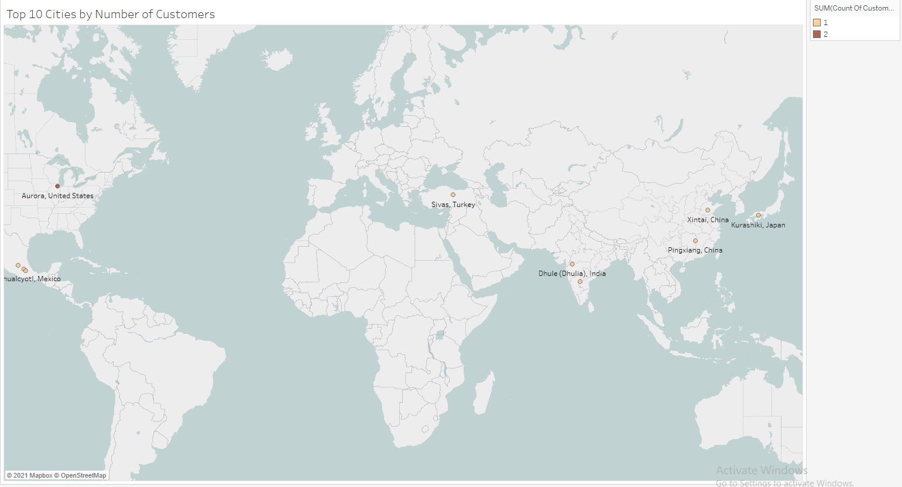
Notes:
In this slide I probably would not show it to the stakeholders, but it doesn’t tell us a lot of valuable information. As you can see, the top amount of customers found within a city are 2. It just is not enough information to gain insights for the company. To make this information more useful, what I would do is expand the number of cities that we are looking at to 50. Along with that see how much money is being made in each city opposed to how many customers are in each city.

Slide 7
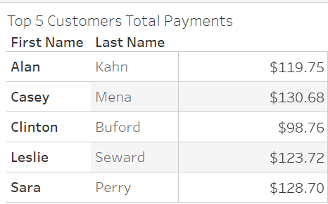

Slide 8
Conclusions
First target roll-out of the streaming service in the U.S
In the top 3 countries with most customers
Next, target Asia and roll out streaming service there
Nearly 50% of top customers are in Asia
Continue to analyze data on inventory, sales in US, stores etc.

Slide 9
Tableau Links
Top 10 Countries: 3.10 - Carter Hofseth - Carter Hofseth | Tableau Public
Top 10 Cities: 3.10 - Step 2 - Carter Hofseth | Tableau Public
Top 5 Customers: 3.10 - Step 3 - Carter Hofseth | Tableau Public

